Slide 1
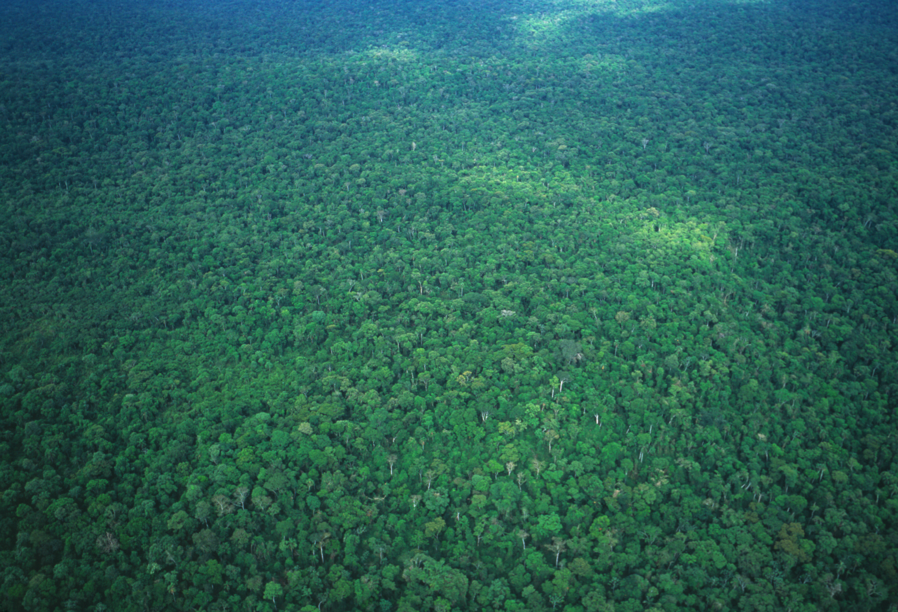
The Assembly and Evolution of the
Amazonian Biota and its Environment
2015 Progress Report
Kyle McDonald
City University of New York
Joel Cracraft
American Museum of Natural History
Dimensions of Biodiversity US-BIOTA-São Paulo
www.amazoniabiodiversity.org
Notes:
project took several years to get off the ground, but here we are, we made it together
We are here because of the great wisdom of FAPESP, NSF, and NASA
They decided to take a chance on an audacious project: it is large in scope, interdisciplinary beyond normal interdisciplinary studies
Yet if all of us collaborators do our jobs, the payoff could be huge

Slide 2
Broad-scale Collaboration
Brazil
Canada
Universidade de São Paulo
University of Toronto
Universidade Federal de Goiás
United States
Universidade Federal do Pará
American Museum of
Natural History
Universidade Estadual
de Campinas
City University New York
Museu Paraense Emílio Goeldi
Field Museum of
Natural History
Instituto Nacional de
Pesquisas da Amazônia
Middle Tennessee
State University
Argentina
Natural History Museum
Los Angeles County
CONICET-Instituto Superior
de Entomologia, Tucumán
New York Botanical Garden
Great Britain
University of Michigan
University of Edinburgh
University of Colorado

Slide 3
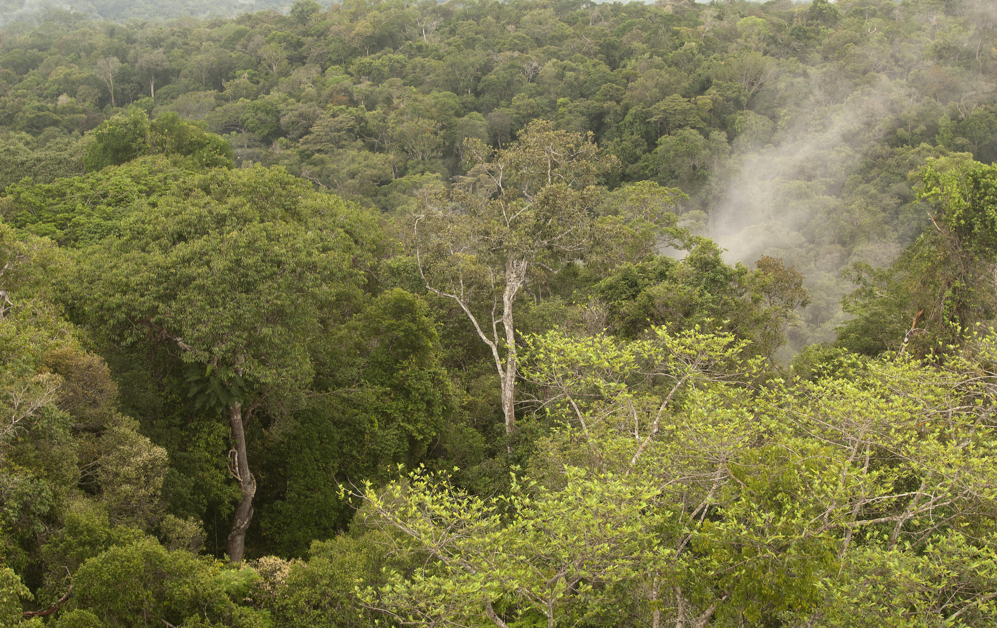
Scientific challenges and goals
How is genetic, taxonomic, and ecological
diversity distributed within Amazonia?
What has been the evolutionary history of the
Amazonian biota and how was it generated?
What has been the history of the Amazonian
aquatic and terrestrial environments?
How has the Amazonian environment and its
biota evolved together, and what have been
the global effects of this evolutionary-
ecological system over time?
Requires a new integrated approach

Slide 4
Integration across disciplines
Systematics
Historical biogeography
Phylogeography
Paleogeography
Tectonics
Geochronology
Remote sensing
Amazonian
History
Population
genetics
Landscape ecology
Ecosystem function/
biogeochemical flows
Paleoclimatology
Palynology
Paleoclimate modeling

Slide 5
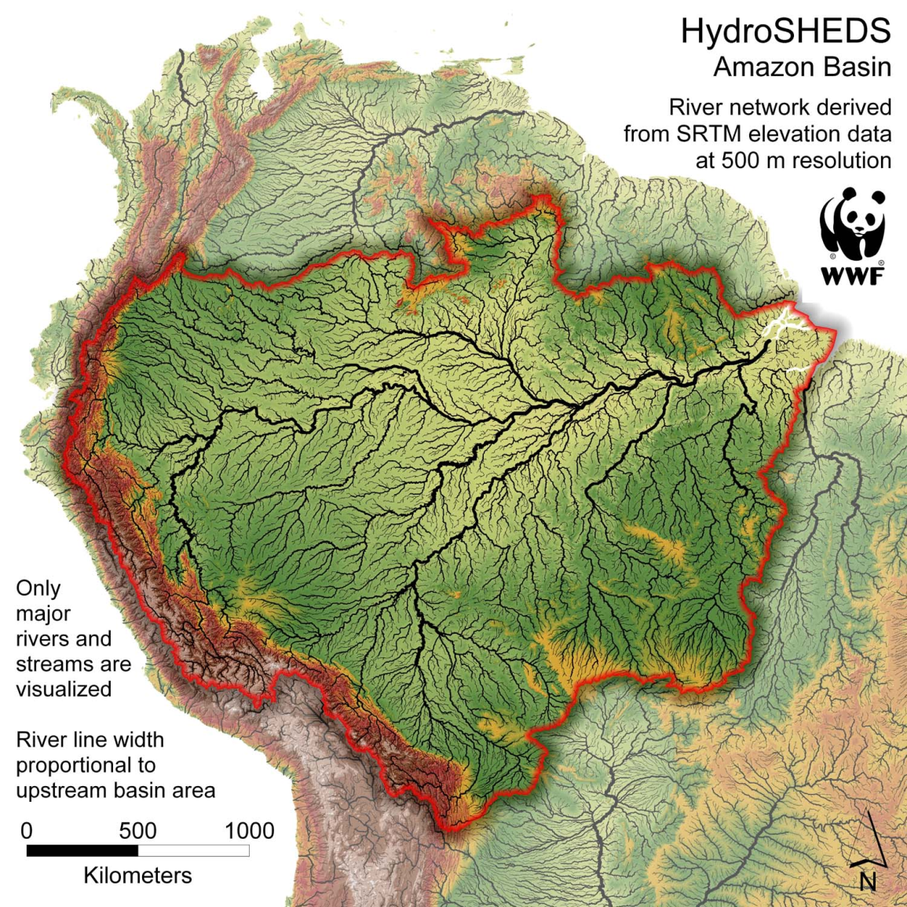
Characterization of the geological and environmental history of Amazonia
- What has been the history of environmental change across Amazonia from the late Neogene to present?
- When did the Amazonian river drainage form?
- What was the Amazonian landscape like before the Amazon river formed and how did it change after the river formation?

Slide 6
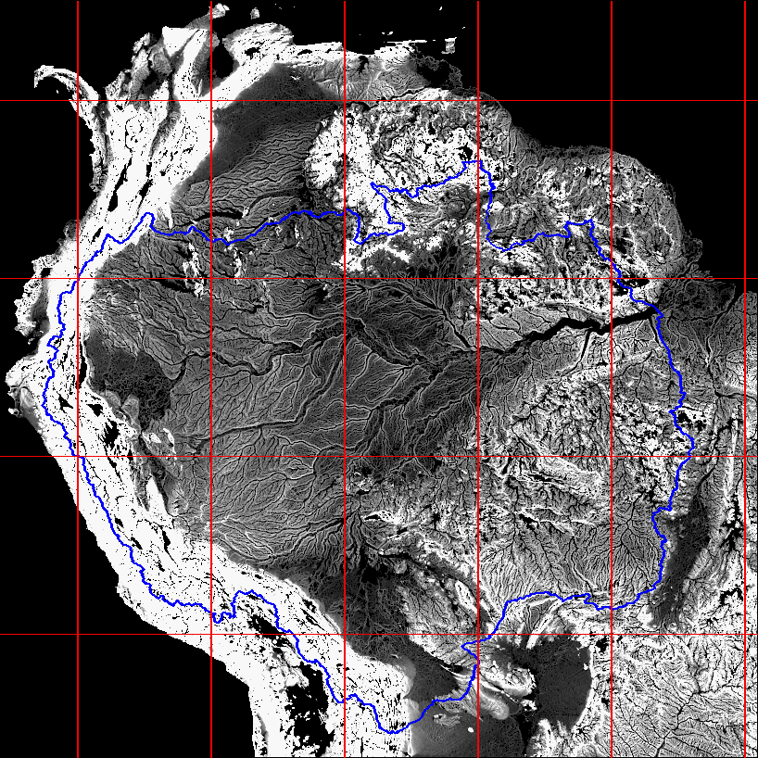
SRTM
% slope at 5 km scale

Slide 7
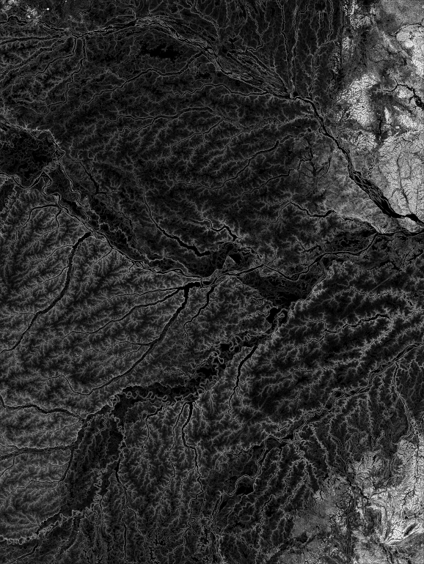
Integrating paleogeography
and remote-sensing using
SRTM
SRTM
% slope at 5 km scale

Slide 8
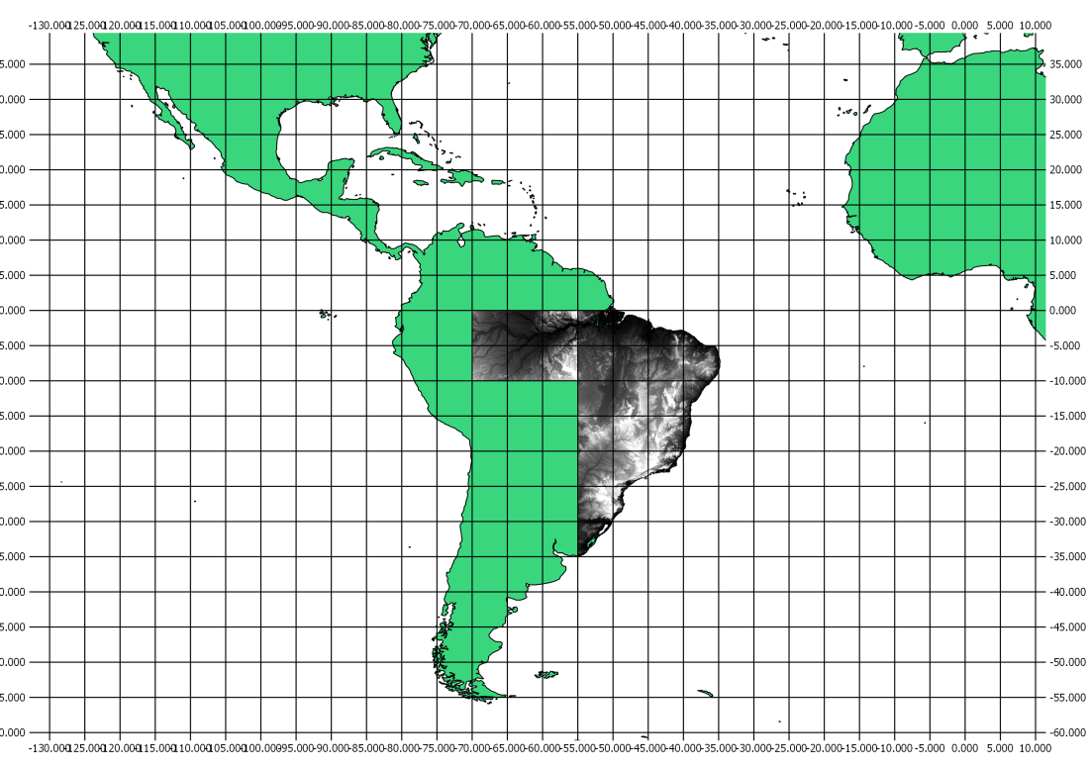
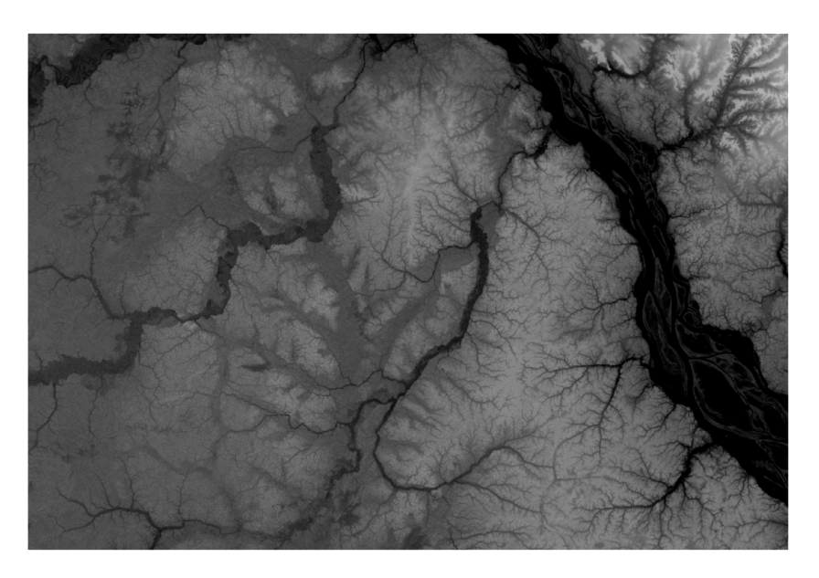
Integration using SRTM DEM: Amazon and the Atlantic Forest
Ancient river system
based on Almeida-Filho & Miranda. 2007. Remote Sensing Environ. 110:387-392
Notes:
Image overlays conducted in QGIS

Slide 9
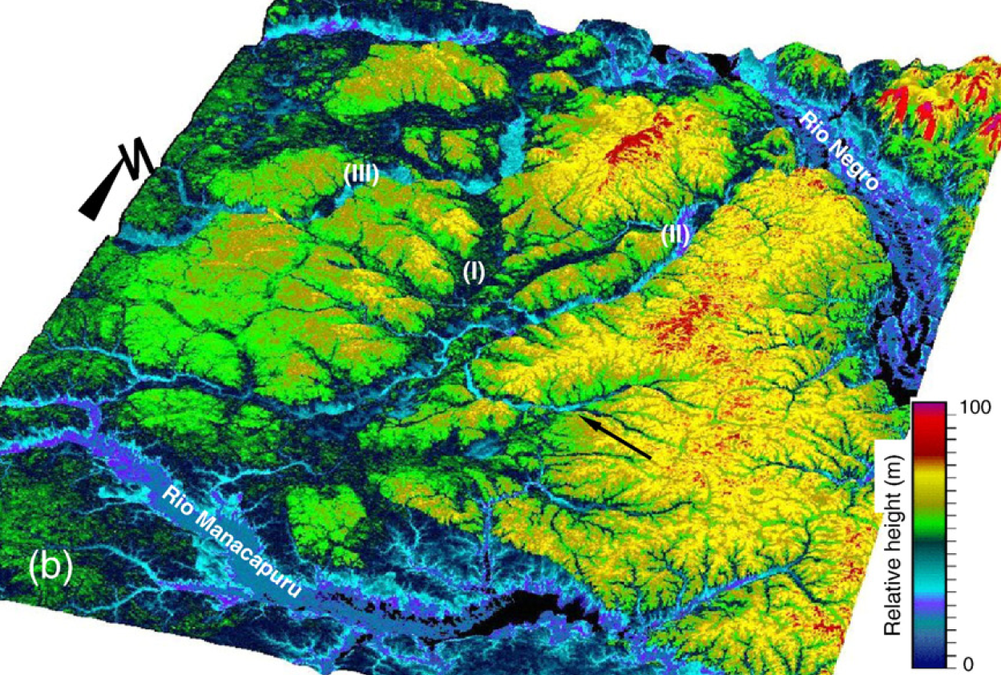
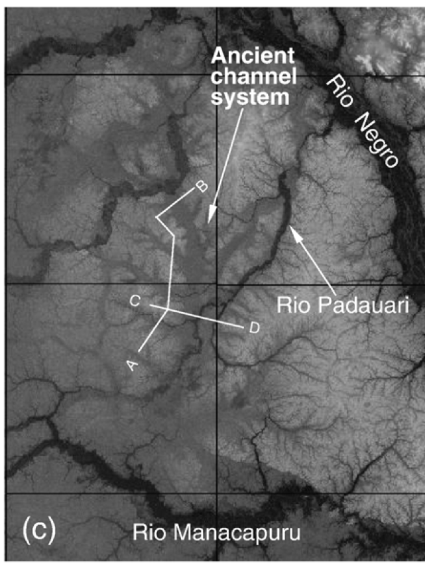
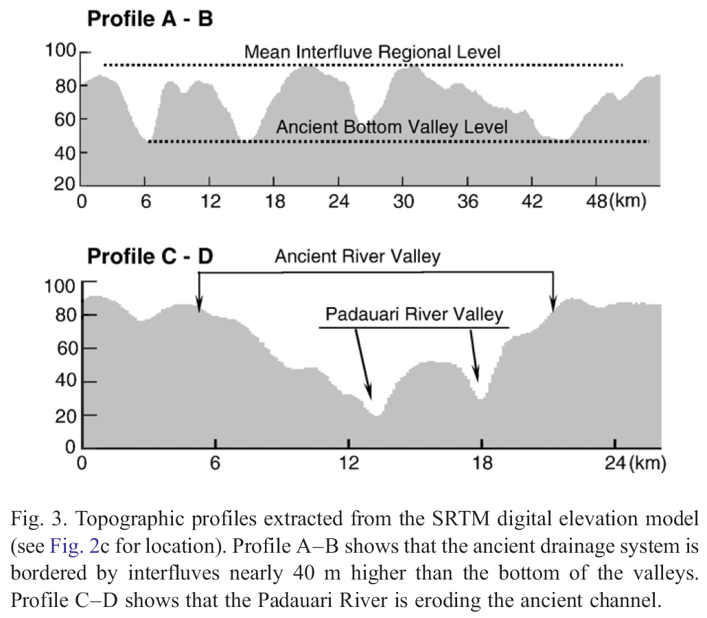
SRTM and Rio Negro
paleogeography
Rio Padauari
Rio Carabinini
paleoriver
SRTM digital
elevation model
Almeida-Filho & Miranda. 2007.
Remote Sensing Environ. 110:387-392

Slide 10
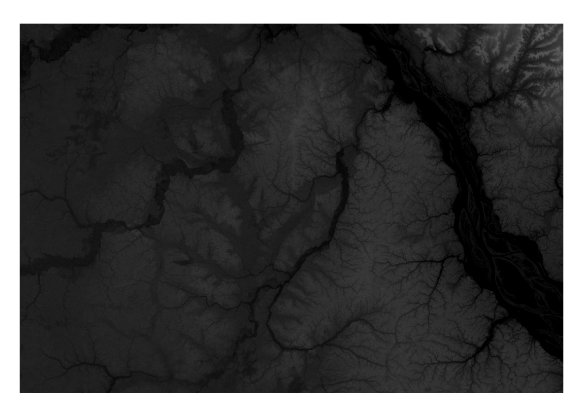
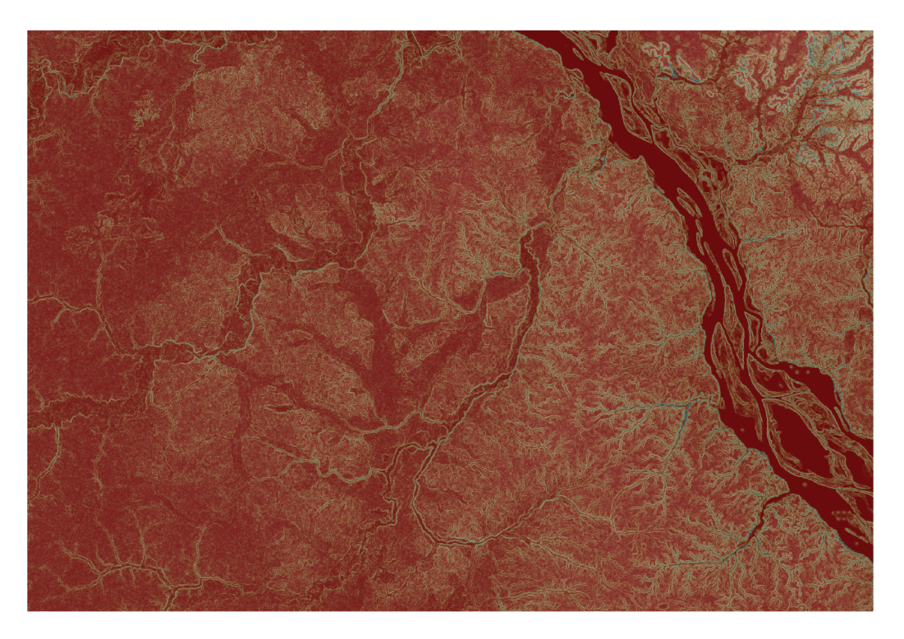
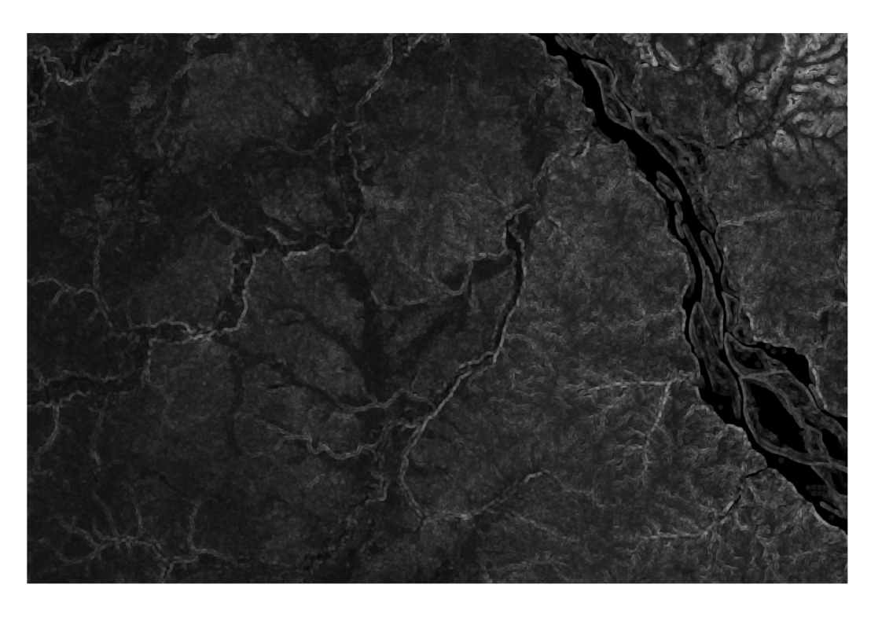
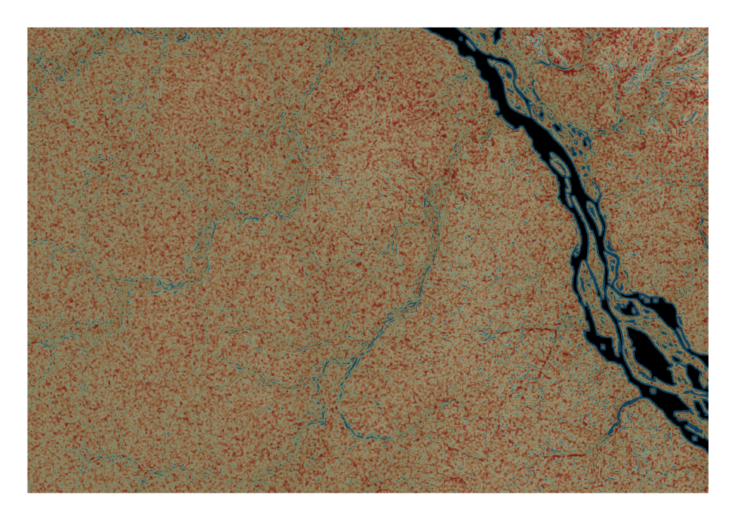
Image overlays carried out in QGIS
SRTM tile 24_13 zoomed in
Slope 50% transparency overlaying srtm image
Standard deviation of slope 50% transparency overlaying srtm image
CV of slope 50% transparency overlaying srtm image

Slide 11
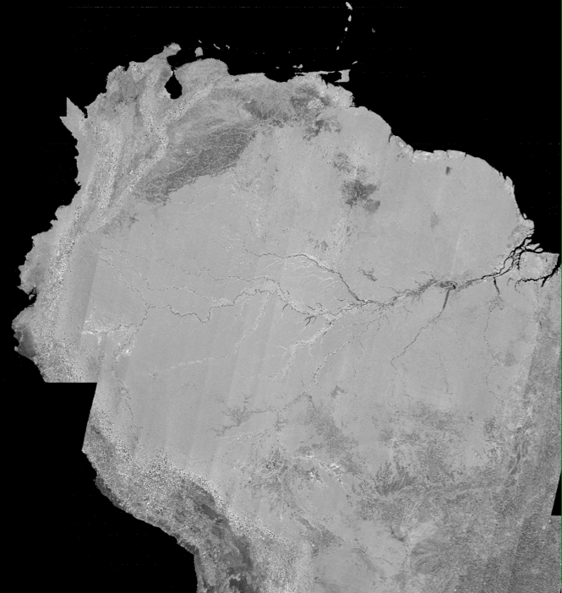
ALOS PALSAR Datasets
The Amazon river basin was imaged ~every 46 days by ALOS (2006-2011), so that inundation dynamics can be monitored
SCANSAR mosaic 2007
3 arcsecond postings (~90m)
Chapman et al . 2015. in press
Notes:
11

Slide 12
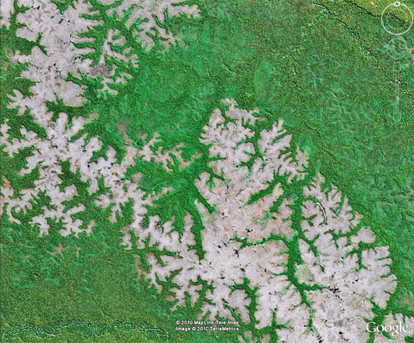

Slide 13
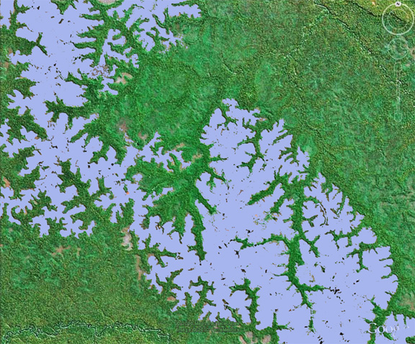

Slide 14
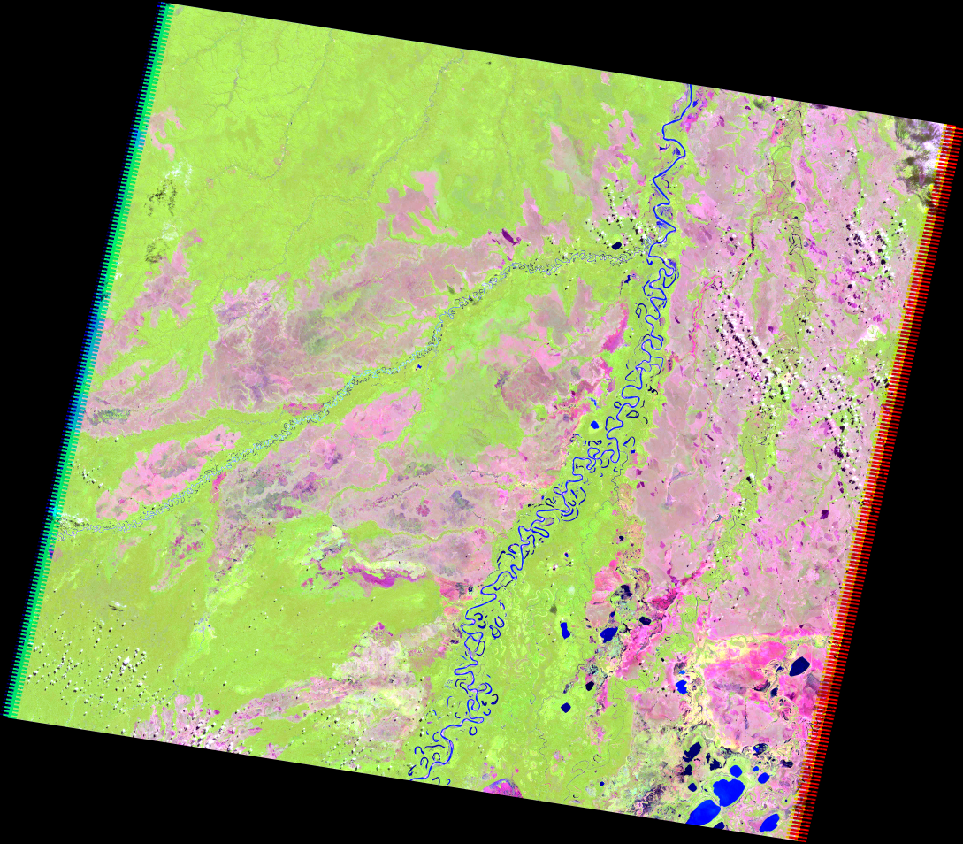
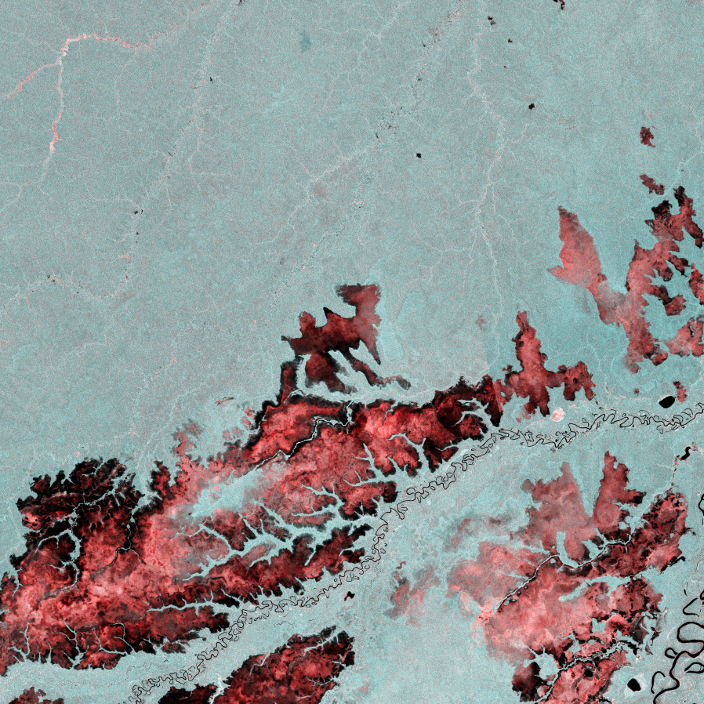
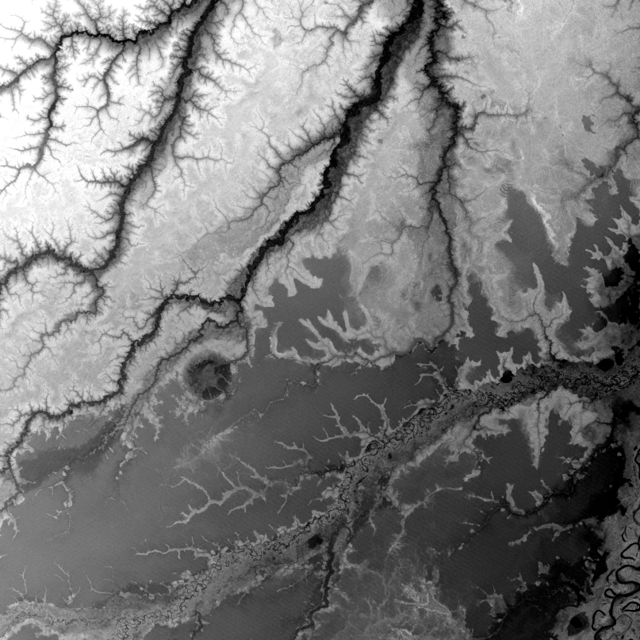
Multi-Sensor Datasets
Landsat 5 ALOS PALSAR SRTM DEM (30m)
Amazon basin bordering Ilanos, northern Bolivia.
Region selected based on Campbell (1990)

Slide 15
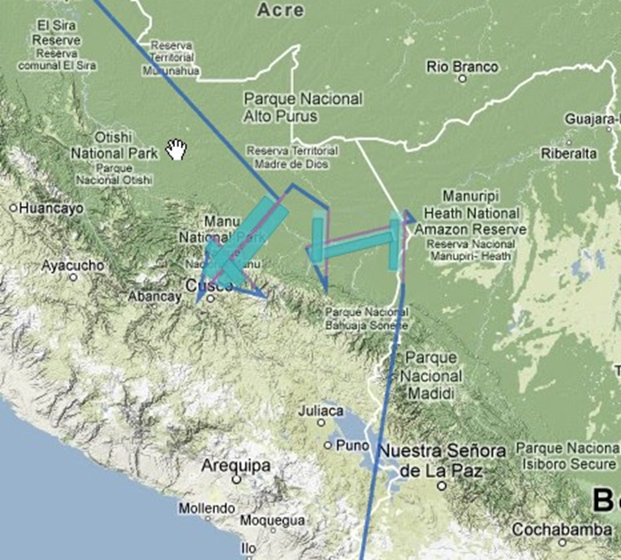

Slide 16
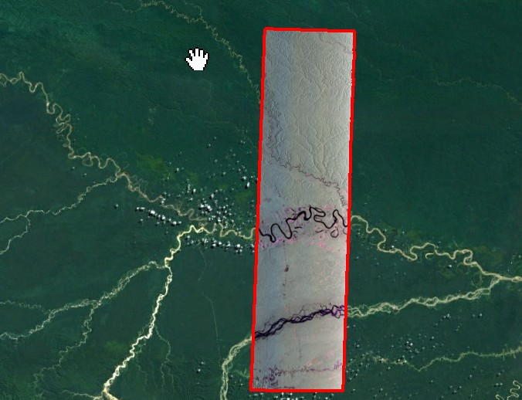
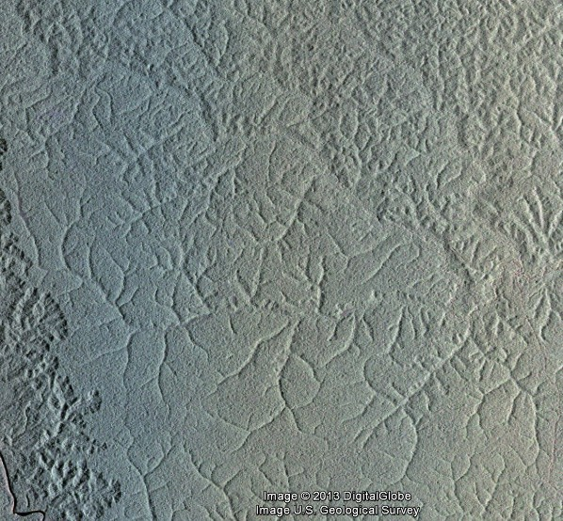
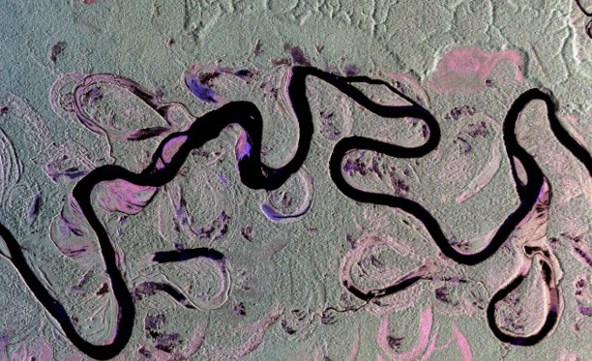
NASA UAVSAR
Madre de Dios
Peru

Slide 18
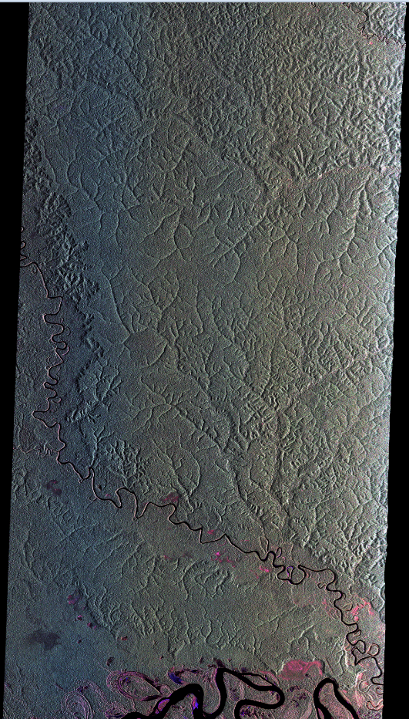

Slide 19
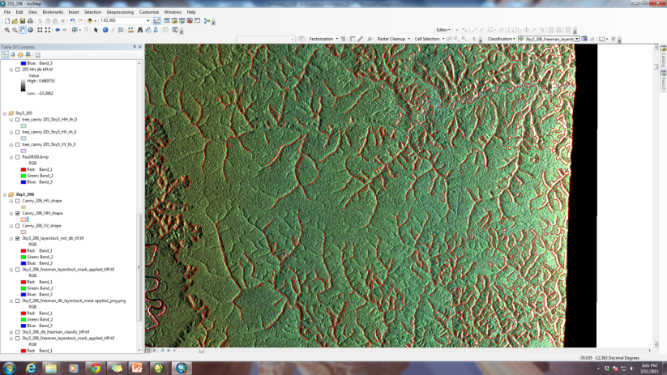

Slide 20
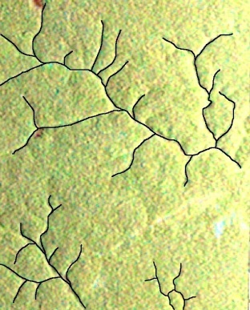
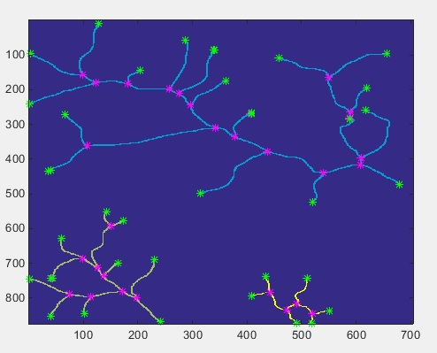
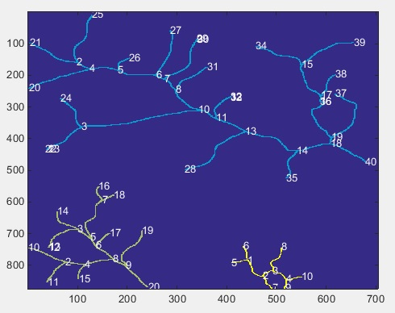
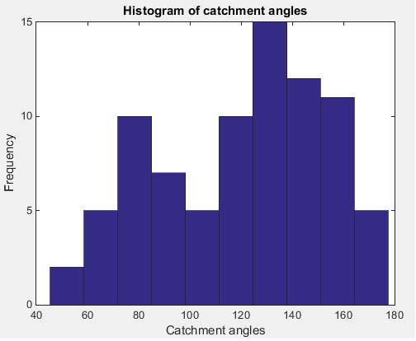
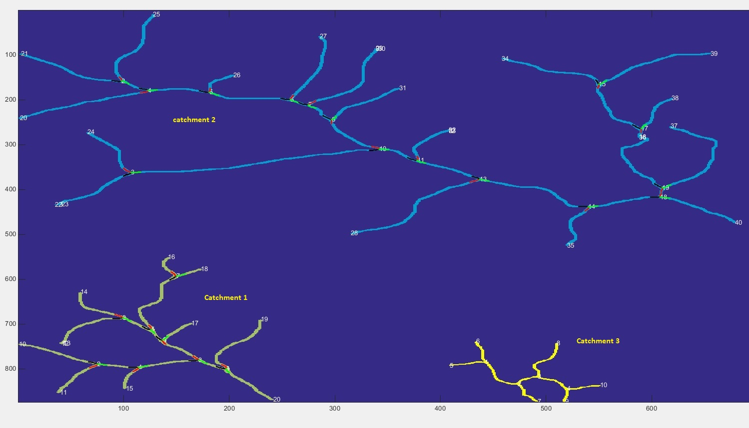
Defining river branch structure

Slide 21
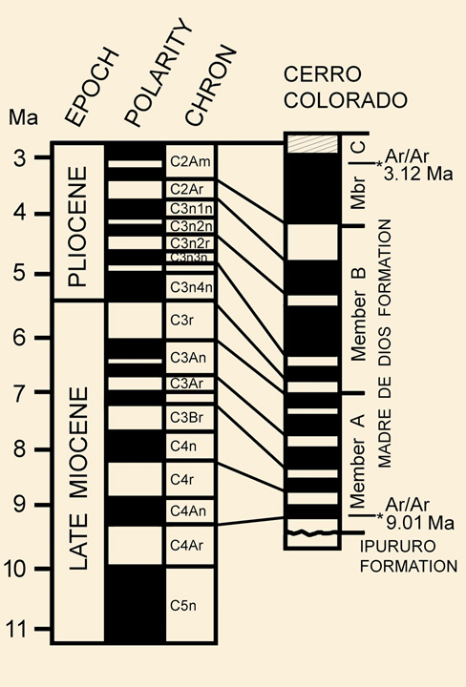
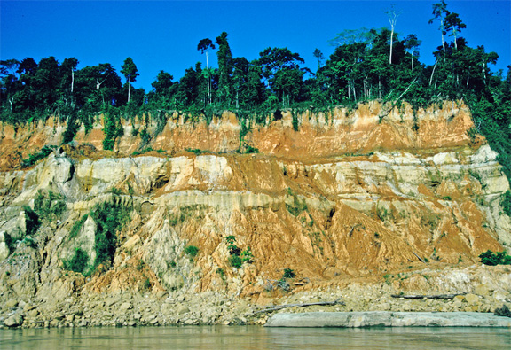
Cerro Colorado Paleomagnetic Dating

Slide 22
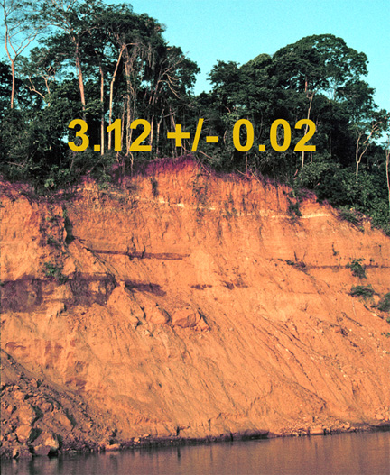
Piedros River Outcrop

Slide 23
UAVSAR-PALSAR Fusion

Slide 24
Georeferencing of Amazonian birds
Goals:
To produce a high-quality database of specimen-based
georeferenced records of birds and primates
To support phylogeographic, phylogenetic, and environmental
modeling analyses of Amazonian birds and primates
Progress to date:
Because data in publically-available databases (e.g., GBIF) are
frequently inaccurate, we have built on those data
using high quality control georeferencing
To date we have approximate 151,000 total records of birds
georeferenced
Current activity focuses on key taxa including manakins
(Pipridae: ~19,000 records), cotingas (Cotingidae: ~4700
records), and now becards and allies(Tityridae: ~5800 records).
These are being used for fine-grain phylogeographic
and paleoenvironmental analysis.

Slide 25
Ongoing phylogenetic and phylogeographic
analyses
We are continuing to collect next-generation sequencing data
using ultra-conserved elements (UCEs) to probe genomes for
~2900 loci (800-900K base pairs/individual)
Goal is to build a phylogeny & timetree for >70% of
Amazonian species
We continue to undertake phylogeographic analyses of
Amazonian species (birds, primates, plants) using next-gen
data with dense sampling across Amazonia in order to
reconstruct demographic and spatial history, leading to
inferences about environmental history (patterns of
change and stability) over time

Slide 26
Revealing cryptic taxa
& evolutionary diversity
Chestnut-tailed Antwren
species-complex
Myrmeciza hemimelaena
The team is discovering many
new lineages with genetic data
previous subspecies
geographic evidence
tree structure
This has profound implications for
how and when Amazonian species
arose and diversified
Fernandes et al. 2012. J. Biogeography

Slide 27
Acknowledgement
Portions of this research were undertaken within the framework of the ALOS Kyoto & Carbon Initiative. The ALOS data were provided by JAXA EORC

Slide 28
Extra Charts

Slide 29
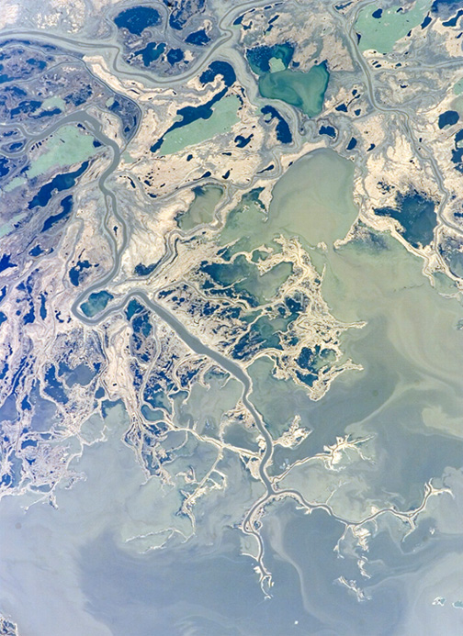
Lake Winnipeg

Slide 30
Using SRTM DEM to map out underlying geomorphology of Brazil
SRTM tile 24_13 zoomed in
Ancient river system
Slope 50% transparency overlaying srtm image
Standard deviation of slope 50% transparency overlaying srtm image
Coefficient of variation of slope 50% transparency overlaying srtm image
Almeida-Filho & Miranda. 2007.
Remote Sensing Environ. 110:387-392
Notes:
Image overlays conducted in QGIS

Slide 31
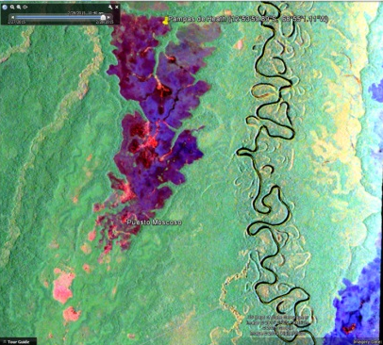
Processing data using polSARpro, ASF Mapready, ENVI, ArcInfo, Matlab
205
HH
RGB_HH, HV, VV
Freeman Decomposition
Canny edge_ Thresh 0.1,sigma 7
PALSAR (12.5 m)
PALSAR_rgb_window 3by3_MEAN
PALSAR_rgb_window 3by3_VARIANCE)
206_rgb
Maximum likelihood classification on Freeman Durden decomposition
RED= Inundated vege, Blue=open water,Green=Vege,Yellow=unknown
205_Freeman decomposition, Pampas de Heath region
Area under yellow box. Canny HH_thresh_0.1_sigma _7.0_ overlaid with 206_Multilook_3by3_ rgb
Area under red box.

Slide 32
Future Work
Work in progress includes developing a robust statistical measures characterizing paleo-channels (inactive drainage channels).
This includes delineating channel typology and branching geometries.
We then will investigate the utility and spaceborne imaging radar to support topology characterization for extrapolation of this technique to the wider Amazon basin scale.

